Slide 1
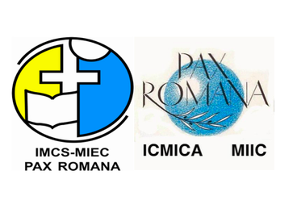
The contribution of Lay movements to building up a synodal Church

Slide 2
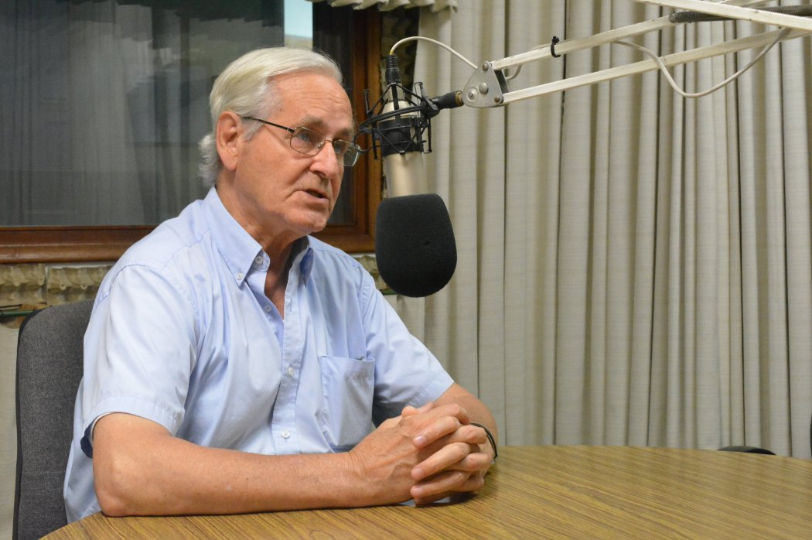

Slide 3
Structure
What do we mean by synodality?
Why does the ongoing synodal process matter?
How can Lay movements contribute?

Slide 4
1) Synodality as a way of being Church
Magisterium
Bishops
Sensus fidei fidelium
HORIZONTAL COMMUNION
MISSION
FULL, ACTIVE
PARTICIPATION
ORDAINED MINISTERS AS A PART OF GOD’S PEOPLE

Slide 5
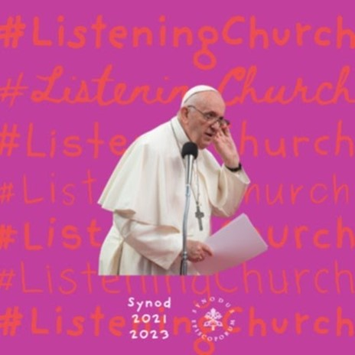
Listening at the center of the Church’s life

Slide 6
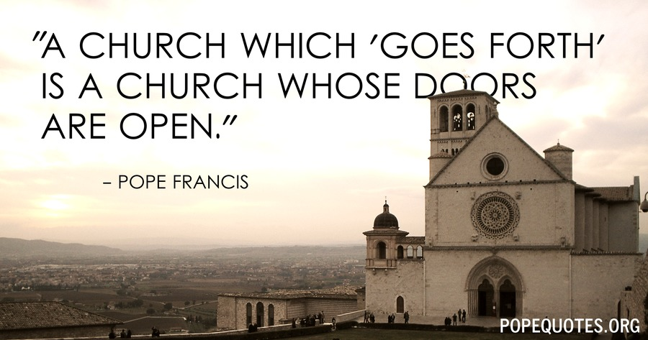
Synodality for the sake of evangelization

Slide 7
2) Why does the ongoing synodal process matter?
Objective:
Engage the entire people of God with a synodal spirituality
Method:
Spiritual conversations to experience synodality

Slide 8
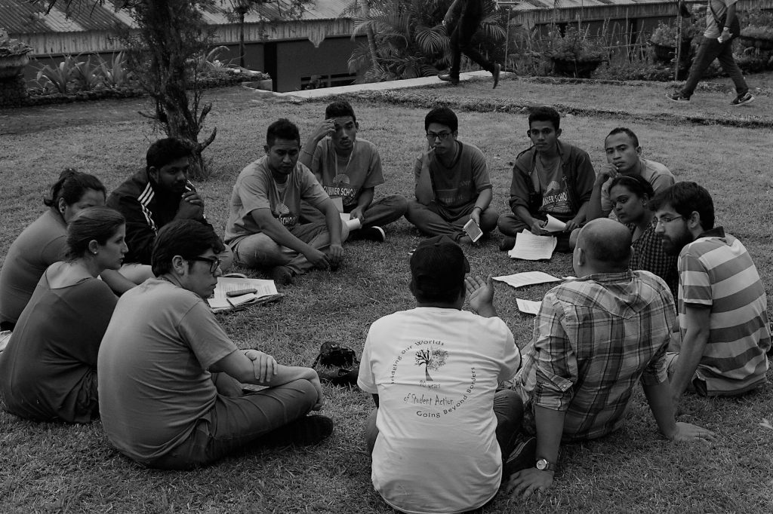
3) How can Lay movements contribute?
Your experience with synodality
A community of equals

Slide 9
3) How can Lay movements contribute?
Open dialogue
Incarnate evangelization

Slide 10
Thank you

